Slide 1
Instance-Based Leaning for Precision Medicine
Md. Sarwar Kamal
Ph.D. Student
Advanced Analytical Institute
UTS, Australia
Supervised by
Professor Dr. Jinyan Li
Program head
Bioinformatics
Advanced Analytical Institute
UTS, Australia

Slide 2
Background
Personalized medicine for Cancer diagnosis is significant for improving current healthcare system.

Slide 3
Research Gap
All Existing researches are working on a fixed model. They Consider all analysis with a global approach.

Slide 4
Research Question
How can a global learning approach be summaries with an instance centric approach?
How propose treatment planning for a new unknown patient?

Slide 5
Instance-Based Learning
A patient is an instance.
Scanning a test instance to all training instances and form a relevance matrix to predict cancer is called Instance-based learning.

Slide 6
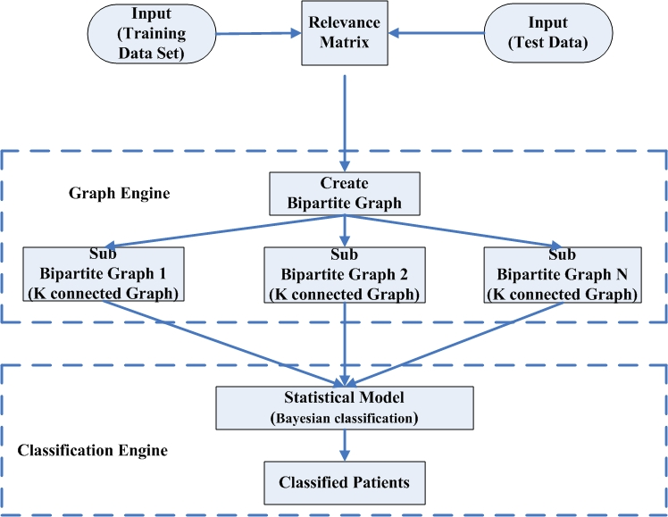
Architecture

Slide 7
Training Instances
Patient ID | F1 | F2 | F3 | F4 | F5 | F6 | F7 | F8 | F9 | Fn | Types
P1 | 0.2 | 0.5 | 0.6 | 0.6 | 0.7 | 0.8 | 0.2 | 0.5 | 0.6 | 0.3 | Negative
P2 | 0.3 | 0.8 | 0.9 | 0.5 | 0.6 | 0.2 | 0.3 | 0.8 | 0.5 | 0.6 | Positive
P3 | 0.6 | 0.7 | 0.8 | 0.8 | 0.9 | 0.3 | 0.6 | 0.7 | 0.8 | 0.9 | Positive
P4 | 0.4 | 0.4 | 0.2 | 0.5 | 0.6 | 0.6 | 0.7 | 0.3 | 0.5 | 0.6 | Negative
P5 | 0.2 | 0.5 | 0.6 | 0.8 | 0.9 | 0.5 | 0.6 | 0.6 | 0.8 | 0.9 | Negative
P6 | 0.3 | 0.8 | 0.9 | 0.7 | 0.8 | 0.8 | 0.9 | 0.7 | 0.3 | 0.5 | Positive
P7 | 0.6 | 0.7 | 0.8 | 0.2 | 0.5 | 0.6 | 0.2 | 0.3 | 0.8 | 0.9 | Positive
P8 | 0.4 | 0.4 | 0.2 | 0.3 | 0.8 | 0.9 | 0.3 | 0.6 | 0.7 | 0.8 | Negative
P9 | 0.2 | 0.5 | 0.6 | 0.3 | 0.8 | 0.9 | 0.3 | 0.8 | 0.9 | 0.2 | Negative
P10 | 0.3 | 0.8 | 0.9 | 0.6 | 0.7 | 0.8 | 0.6 | 0.7 | 0.8 | 0.3 | Positive

Slide 8
Test Instance
Patient ID | F1 | F2 | F3 | F4 | F5 | F6 | F7 | F8 | F9 | Fn | Types
P11 | 0.6 | 0.7 | 0.9 | 0.2 | 0.5 | 0.6 | 0.6 | 0.7 | 0.8 | 0.9 | ?

Slide 9

Relevance matrix
Generate the relevance matrix by using following formulas:
If we compare the feature, F1 of patient P1 and P11 we find out the similarity score is
S_Score =|(0.2-0.6)|
=0.4 , so assign 0.

Slide 10
Relevance matrix [ Cont…]
Similarity score calculated by using following equation:
If we compare the feature, F1 of patient P1 and P11 we find out the similarity score is
S_Score =1- |(0.2-0.6)|
=1-0.4 =0.6

Slide 11
Relevance Matrix Generation
Training data set
Patient ID | F1 | F2 | F3 | F4 | F5 | F6 | F7 | F8 | F9 | Fn | Types
P1 | 0.2 | 0.5 | 0.6 | 0.6 | 0.7 | 0.8 | 0.2 | 0.5 | 0.6 | 0.3 | Negative
P2 | 0.3 | 0.8 | 0.9 | 0.5 | 0.6 | 0.2 | 0.3 | 0.8 | 0.5 | 0.6 | Positive
P3 | 0.6 | 0.7 | 0.8 | 0.8 | 0.9 | 0.3 | 0.6 | 0.7 | 0.8 | 0.9 | Positive
P4 | 0.4 | 0.4 | 0.2 | 0.5 | 0.6 | 0.6 | 0.7 | 0.3 | 0.5 | 0.6 | Negative
P5 | 0.2 | 0.5 | 0.6 | 0.8 | 0.9 | 0.5 | 0.6 | 0.6 | 0.8 | 0.9 | Negative
P6 | 0.3 | 0.8 | 0.9 | 0.7 | 0.8 | 0.8 | 0.9 | 0.7 | 0.3 | 0.5 | Positive
P7 | 0.6 | 0.7 | 0.8 | 0.2 | 0.5 | 0.6 | 0.2 | 0.3 | 0.8 | 0.9 | Positive
P8 | 0.4 | 0.4 | 0.2 | 0.3 | 0.8 | 0.9 | 0.3 | 0.6 | 0.7 | 0.8 | Negative
P9 | 0.2 | 0.5 | 0.6 | 0.3 | 0.8 | 0.9 | 0.3 | 0.8 | 0.9 | 0.2 | Negative
P10 | 0.3 | 0.8 | 0.9 | 0.6 | 0.7 | 0.8 | 0.6 | 0.7 | 0.8 | 0.3 | Positive
Compare with F1 feature of P1 and P11 patient
Patient ID | F1 | F2 | F3 | F4 | F5 | F6 | F7 | F8 | F9 | Fn | Types
P11 | 0.6 | 0.7 | 0.9 | 0.2 | 0.5 | 0.6 | 0.6 | 0.7 | 0.8 | 0.9 | ?
Test data set
Patient ID | F1 | F2 | F3 | F4 | F5 | F6 | F7 | F8 | F9 | F10 | Types
P1 | 0.2 | 0 | 0.6 | 0.6 | 0 | 0 | 0.2 | 0 | 0 | 0.3 | Negative
P2 | 0.3 | 0.8 | 0.9 | 0.5 | 0.6 | 0.2 | 0.3 | 0.8 | 0.5 | 0.6 | Positive
P3 | 1 | 1 | 0 | 0.8 | 0.9 | 0.3 | 1 | 1 | 1 | 1 | Positive
P4 | 0 | 0.4 | 0.2 | 0.5 | 0 | 1 | 0 | 0.3 | 0.5 | 0.6 | Negative
P5 | 0.2 | 0 | 0.6 | 0.8 | 0.9 | 0 | 1 | 0 | 1 | 1 | Negative
P6 | 0.3 | 0.8 | 0.9 | 0.7 | 0.8 | 0.8 | 0.9 | 1 | 0.3 | 0.5 | Positive
P7 | 1 | 1 | 0 | 1 | 1 | 1 | 0.2 | 0.3 | 1 | 1 | Positive
P8 | 0 | 0.4 | 0.2 | 0 | 0.8 | 0.9 | 0.3 | 0 | 0 | 0 | Negative
P9 | 0.2 | 0 | 0.6 | 0 | 0.8 | 0.9 | 0.3 | 0 | 0 | 0.2 | Negative
P10 | 0.3 | 0 | 1 | 0.6 | 0 | 0 | 1 | 1 | 1 | 0.3 | Positive
Relevance Matrix
|0.2-0.6|=0.4<1
So value of P1 assign in relevance matrix

Slide 12
Relevance matrix
Patient ID | F1 | F2 | F3 | F4 | F5 | F6 | F7 | F8 | F9 | Fn | Types
P1 | 0.2 | 0 | 0.6 | 0.6 | 0 | 0 | 0.2 | 0 | 0 | 0.3 | Negative
P2 | 0.3 | 0.8 | 0.9 | 0.5 | 0.6 | 0.2 | 0.3 | 0.8 | 0.5 | 0.6 | Positive
P3 | 1 | 1 | 0 | 0.8 | 0.9 | 0.3 | 1 | 1 | 1 | 1 | Positive
P4 | 0 | 0.4 | 0.2 | 0.5 | 0 | 1 | 0 | 0.3 | 0.5 | 0.6 | Negative
P5 | 0.2 | 0 | 0.6 | 0.8 | 0.9 | 0 | 1 | 0 | 1 | 1 | Negative
P6 | 0.3 | 0.8 | 0.9 | 0.7 | 0.8 | 0.8 | 0.9 | 1 | 0.3 | 0.5 | Positive
P7 | 1 | 1 | 0 | 1 | 1 | 1 | 0.2 | 0.3 | 1 | 1 | Positive
P8 | 0 | 0.4 | 0.2 | 0 | 0.8 | 0.9 | 0.3 | 0 | 0 | 0 | Negative
P9 | 0.2 | 0 | 0.6 | 0 | 0.8 | 0.9 | 0.3 | 0 | 0 | 0.2 | Negative
P10 | 0.3 | 0 | 1 | 0.6 | 0 | 0 | 1 | 1 | 1 | 0.3 | Positive

Slide 13
Bipartite Graph
Design a bipartite graph from relevance matrix.
P1
F1
P2
F2
Patients
Set
Features
Set
P3
F3
P4
F4
Pn
Fn

Slide 14
Sub-graph generation
K-connected approach is used for sub graphing.
Why k-connected?
K-edge connected graph are efficiently connected in graph decomposing . K-edge connected graph significantly increased.

Slide 15
Sub-Graph
K- connected sub graphing are proceeded until all the features are covered. When we find all the features then we stop k-connected sub graph.
Different type of K-connected for sub graph:
6-connected graph
7-connected graph
8-connected graph
9-connected graph

Slide 16
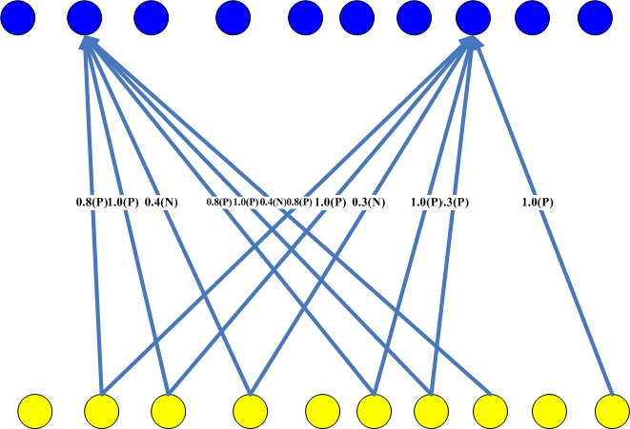
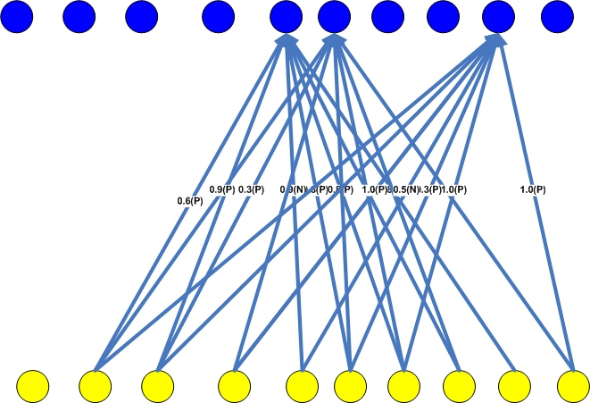
Sub-Graph
P1
F1
P2
F2
6-connected Graph
Sub graphing
P3
F3
P4
F4
Pn
Fn
Sub graphing
7-connected Graph
Bipartite Graph
Patient
Feature

Slide 17
Statistical Model
Bayesian classification or theorem for prediction cancer patient
The generalized equation of Bayesian classification is

Slide 18
Maximum A Posterior (MAP)
An input B, find the largest one from N probabilities output by a discriminative probabilistic classifier

Slide 19
Sub-graph Analysis
Probabilistic value for 6-connected graph:
Probabilistic value for 7-connected graph:
Probabilistic value for 9-connected graph:
F2 | F8
0.48 (N) | 0.17 (P)
F5 | F6 | F9
0.76 (P) | 0.47 (P) | 0.67 (P)
F1 | F3 | F4
0.042(P) | 0.169 (P) | 0.36 (P)

Slide 20
Sub graph Analysis [ Cont…]
Probabilistic value for 9-connected graph:
Probabilistic value for whole bipartite graph:
Patient is type
F7 | F10
0.041(N) | 0.080 (P)
F1 | F2 | F3 | F4 | F5 | F6 | F7 | F8 | F9 | F10
0.042 (P) | 0.48 (N) | 0.169(P) | 0.36(P) | 0.76 (P) | 0.47 (P) | 0.041(N) | 0.17 (P) | 0.67 (P) | 0.080(P)
Positive
Negative
Applying MAP Rule
Positive

Slide 21
Implementation
Matlab and Weka tool.
Multiple datasets.
Evaluation parameters:
Precision
Recall
Accuracy
F-Measure

Slide 22
Implementation [ Cont…]
Precision express the proportion of the data points our model says was relevant actually were relevant.

Slide 23
Implementation [ Cont…]
Recall express the ability to find all relevant instances in a dataset.
Improving precision typically reduces recall and vice
versa.

Slide 24
Implementation [ Cont…]
Accuracy is the most intuitive performance measure and it is simply a ratio of correctly predicted observation to the total observations.
F1 Score is the weighted average of Precision and Recall. It takes both false positives and false negatives.

Slide 25
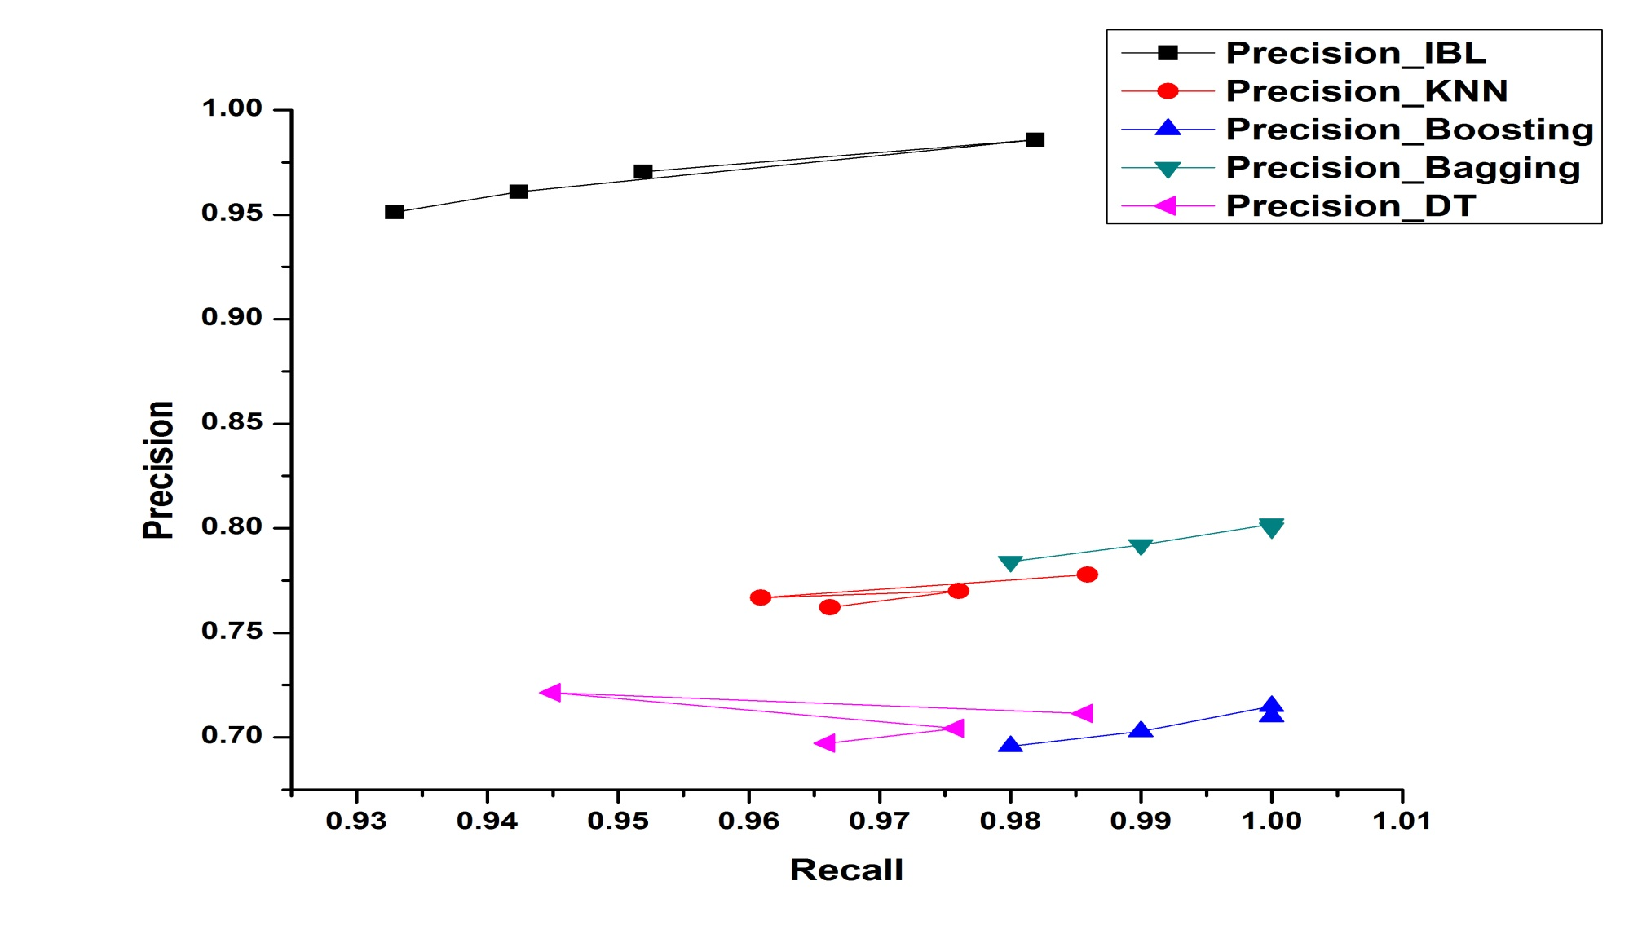
Precision vs. Recall
High Precision for IBL

Slide 26
Similarity Group
We find out the similarity between the patients.
We compare the test patient with training data set and make several group which are most similar or not.
We make three groups:
Group1: 100% to 90% is maximum similar.
Group 2: 89% to 80% is average similar
Group 3: less 80% is less similar
Maximum similar group indicates that the test patient is most similar with the patients that belong in Group1.

Slide 27
Similarity Group [ Cont…]
Training Value
Test Value
G11
Group 1
(100 % to 90%)
G12
F11
F21
T1
G13
F12
F22
T2
G1n
F13
F23
T3
Mean Comparison
G21
F1n
F2n
Tn
Group 2
(89 % to 80%)
G22
G23
G2n
0 to 1 Data
0 to 1 Data
Fuzzy Value
(Test Data)
Fuzzy Value
(Training Data)
G31
Group 3
(less than 80%)
G32
G33
G3n

Slide 28
Gene Ranking
We rank the gene list that are responsible for corresponding cancer disease.
We generate a rank list based on mean of fluorescent value.
Maximum average value of fluorescent is indicates the most responsible gene.
We also use GSEA tool to justify our rank list.
Both rank lists (GSEA and Our method) are same.

Slide 29
Gene Ranking [ Cont…]
F1
F1
RF1
F2
F2
RF2
Mean value
Mean
Calculation
Euclidian
Distance
F3
Gene Order
F3
RF3
Fn
Fn
RFn
Rank Gene
Florescent Value
Training Data

Slide 30
Gene Ranking [ Cont…]
Gene Name (Rank list)
GSTO2
AXIN2
LOC89944
ZNRF3
ARHGAP8
ARHGAP8 /// LOC55315
MARCKSL1
DEGS2
MYCL1
APEX1
PATZ1
GBAS
EIF4B
RP5-875H10.1
EIF3S7
FAM86C
…………

Slide 31
Q & A

